Slide 1
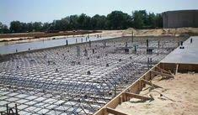
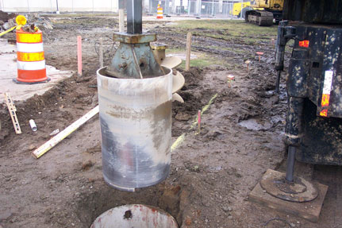
The Business of Geotechnical and Structural Engineers Working Together
Presenter: Stephanie Slocum, P.E. Engineers Rising LLC
Chair of the SEI Business Practices Committee
Notes:
Good evening. Today we will be discussing how geotechnical and structural engineers work together from a business perspective.
My name is Stephanie Slocum. I am a structural engineer turned engineering leadership consultant. I am the founder of Engineers Rising LLC, where I helps engineers learn the leadership and people skills they need to let their technical abilities shine. Prior to founding my company earlier this year, I worked for 15 years as a structural consulting engineer specializing in commercial buildings.

Slide 2
Contact info for all presenters, copies of this presentation, and other supporting materials are available for download at:
www.engineersrising.com/seimd
Notes:
Before we get started, I wanted to let you know that this presentation, slide notes, and links to much of the supporting material I reference are available for download here. We’ll put this slide up again at the end also.

Slide 3
The Backstory
The Backstory
Notes:
This presentation was originally put together as part of the SEI Business Practices Committee work for the Geo-Structures Congress in 2016.
Did any of you attend that congress?
I happen to be the chair of that committee. The purpose of the Business Practices Committee is to consider the issues that relate to the role of the structural engineer in the business environment and within the public at large. Committee membership is entirely comprised of practicing structural engineers, many of which are principals or owners in their firms from all over the country.
We were sitting around a table discussing how the business relationships around the country between geotechnical and structural engineers differ. And, since almost all this information were things we had “learned from experience” over the years, we thought it would be really useful to put together of overview of what the engineering community is currently doing, best practices and what we could do better.
The GI and SEI Congress committee agreed, and we presented this information during the 2016 structures congress.
Then last year, Dave Kozera (our special guest), approached me about bringing this presentation to you, and here we are. Of course, we’ve updated any info as needed, but the basic premise is the same.
So, without further ado, let’s get started.

Slide 4
Summary
Contractual Relationships
Geotechnical RFP’s
Working with a soils report
Foundation design
Construction Phase
Open Discussion with Dave
Notes:
Our goal today is to educate you on the geotechnical engineer and structural engineer business relationship from project conception through construction.
First we will discuss contractual relationships of geotechnical and structural engineers, followed by geotechnical RFP’s. We will talk about how to work with a soils report, including potential liabilities of deviating from the report. We will touch on collaboration during the foundation design process and the geotechnical and structural engineer interaction in the construction phase.
Finally we’ll conclude with an interactive discussion with Dave where you’ll be encouraged to ask questions.
Now, I know this subject can be a little dry. Therefore, we’ve also tried to intersperse some audience participation questions using an online app called Mentimeter. You’ll want to have your phones available to participate.

Slide 5
Contractual Relationships
Owner
Architect
Geotech
Structural
Geotechnical report is an owner furnished item per AIA documents.
Typical in the building world
Contract type typically a geotech-drafted service agreement.
Notes:
Let’s talk about common contractual relationships between geotechnical and structural engineer.
The first type is where the owner contracts the geotechnical consultant and an architect separately. The structural engineer is contracted to the architect.
The AIA documents state that the geotechnical report is an owner furnished item. Therefore, as you imagine this is a typical contract type in the building world. The contract between the geotechnical engineer and the owner is often a geotech-drafted services agreement. In these cases, the structural engineer will typically send out an RFP with specific requirements, which will be attached to the geotech’s service agreement. We will discuss those requirements in detail later in this presentation.

Slide 6
Contractual Relationships
Owner or Contractor
Geotech
Structural
IPD, Design-build, or forensic investigations.
Contract DBIA #540 or similar
Geotechnical engineer treated as a design team member, most comprehensive approach in current practice.
Notes:
The second common contractual relationship is one in which all consultants are contracted to either the owner or GC.
Examples of project types where this is common are IPD or design-build architectural projects, developer work, and forensic investigations.
For the design-build and IPD agreements, the geotechnical engineer is often treated as a design consultant, using standard consultant forms such as DBIA Document No. 540 - Standard Form of Agreement Between Design-Builder and Design Consultant.
Since means and methods of construction and unforeseen conditions play a large part in foundation design methodology, this is the most comprehensive approach used in current practice. In this approach the assumptions made by both structural and geotechnical engineer are either confirmed or invalidated during pre-construction and construction.

Slide 7
Contractual Relationships
Geotech
Structural
Bridge or Forensic Project types
Contract examples:
CASE Contract #10 – Agreement Between Structural EOR and Geotech EOR, 2015
EJCDC E-564 – Agreement Between Engineer and Geotech Engineer, 2015
CASE Contract #3 Agreement between structural engineer and engineering sub-consultant in cases with limited scope of services
Notes:
The third common contractual relationship is one in which the structural engineer is either contracted to the geotechnical engineer or visa-versa.
This is common in the bridge world and may also occur on forensic projects. There are a number of standard contract forms that can be used as listed here.

Slide 8
Contractual Relationships
If both geotech and structural services are provided in-house:
Two contracts are typical.
Greater insurance needs and liability than providing only one service, particularly if scope of services during construction involves inspections
Greater potential risk and reward
Notes:
For any of the three project types we just discussed, we’d like to touch on the unique risks and rewards if your firm provides both structural and geotechnical engineering services. Please raise your hand if your firm provides both services.
First, typically there are two separate contracts for these services.
There are greater insurance needs than providing only one service as a result of the potential for increased liability. This is because of greater potential risk and reward if both services are provided in house.

Slide 9
Contracts: What is your experience?
Notes:
Now we’d like some audience participation. Of the three contract types, which do you prefer?

Slide 10
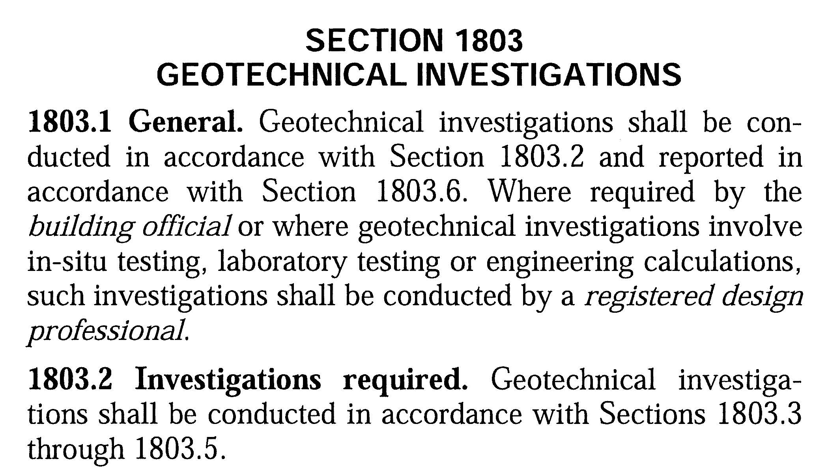
Geotechnical RFP’s
IBC 1803 dictates when a soils report is required.
Notes:
IBC 2012-2018 section 1803 indicates when a geotechnical report is required. Examples of conditions where a report would be required include areas of expansive soils, variable rock strata, and projects with seismic design categories C through F.

Slide 11
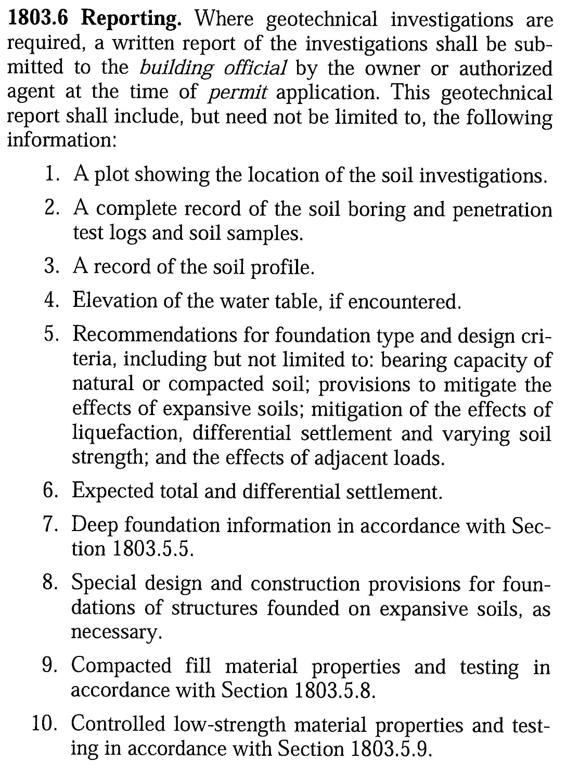
Geotechnical RFP’s
Code minimum reporting requirements.
Notes:
IBC also indicates minimum requirements for reports which you can see here.

Slide 12
Geotechnical RFP’s
What if a geotechnical investigation is not required?
Building Owner should be made aware of risks associated with not obtaining a geotechnical investigation:
External geologic hazards (sloughing, settlement, soil failure).
Financial risks (prescriptive design may be overly conservative).
Project delays (unforeseen conditions).
Operational risks (long-term maintenance issues).
Notes:
Let’s say a geotechnical investigation is not technically required on your project. One example where this could occur are small renovations/additions to buildings where we may have existing drawings and/or a very old soils report.
In these conditions, the owner should be made of external geologic hazards such as sloughing, settlement, or soil failure. Financial risks related to prescriptive design being overly conservative;
Project delays due to unforeseen conditions
Operational risks due to long term maintenance issues (such as settlement).
For many projects, the return on investment for the geotechnical investigation is well worth the cost even if not technically required.
One example – we have a project with a small addition to an existing building. The existing building was built in the 1960’s on caissons, and original existing drawings showing the caisson locations, loads, boring information and foundation design criteria were available. Regardless, the owner did a geotechnical investigation which revealed that due to the low loads on the addition, we could use spread footings instead of caissons, which saved the owner more than 10 times the cost of the investigation just in foundation installation.

Slide 13
Geotechnical RFP’s
RFP document resources
AIA C202-2015
CASE #6-2
AIA G-602
Covers contractual issues and limited structural requirements.
Includes a detailed list of items to be included in the report as well as design consulting requirements for geotech.
Comprehensive scoping list for a geotechnical RFP.
Notes:
Now that we’ve established that a geotechnical investigation is needed, let’s discuss document references for creating an RFP.
The old AIA G-602 covered contractual issues and limited structural requirements but overlooked the geotechnical engineer’s needs. A new AIA document AIA C202-2015 does include a detailed list of items the geotechnical engineer must include in the report as well as a requirement for the geotechnical engineer to be available for consulting during the design process.
CASE #6-2 is comprehensive RFP list, developed by collaboration between geotechnical and structural engineers.
A survey of our committee members indicates that the consulting firms have created their own standard RFP based on their own experience and project type expertise. Let’s discuss some of the items that should be included in a well-written RFP.

Slide 14
RFP Writing: Best Practices
Examples of information structural engineers should provide to geotechnical engineer:
Accurate loads
Preliminary plan including column locations
Type of structural system
Info on use of proposed structure/adjacent facilities
A specific list of items needed from the geotechnical recommendations, including multiple foundation options if desired.
Requirement for geotech to review completed foundation drawings should be included.
Notes:
The structural engineer should include in the RFP sufficient information for the Geotechnical Engineer to provide a proper Geotechnical Report that addresses the needs of the Structural Engineer.
This includes items such as those listed here. Items of emphasis include an accurate site plan with accurate loads. The RFP should include a check list of items needed, for example seismic site classification and lateral earth pressures for retaining wall design, so report expectations are clearly communicated.
If items such as multiple foundation options or geotechnical consulting during design are desired, this should be included in the RFP.

Slide 15
RFP Writing: Best Practices
Examples of information geotechnical engineers should provide to structural engineer:
Clear and unambiguous recommendations for foundation system.
Clear testing recommendations for fill materials, if any, including criteria for using onsite soils if allowed.
Response to checklist of items required that structural engineer has provided.
Additional testing recommendations if needed.
Notes:
The geotechnical engineer should then provide to the structural engineer clear foundation system recommendations and responses to lists of items the structural engineer has provided.

Slide 16
RFP Writing: Structural Engineer Poll
Notes:
It’s audience participation time again. If you’re a structural engineer, please answer the question.
Don’t worry geotechnical engineers, you’re next.

Slide 17
RFP Writing: Geotechnical Engineer Poll
Notes:
For the geotechnical engineers in the room,

Slide 18
Working with a Soils Report
Review the report.
Can the structural engineer’s design deviate from report recommendations?
Unexpected Field Conditions
Old Construction Debris
Poorer soil conditions than expected
Differing stratum elevations
Sink holes and other catastrophic elements
Owner Education Crucial
Notes:
So now we have a geotechnical report, what next?
SE’s should review and detail and verify information requested has been included. Even with a well written RFP and dialogue between the engineers, most reports warrant at least a phone call to discuss questions and clarify recommendations.
Structural engineers should not deviate from the report. Any change to the report or additional information provided should be issued via a supplemental letter or addendum. Further, as a best practice the geotechnical engineer should review and comment on the completed foundation design drawings and specifications related to foundations. This should be stated up-front in the RFP.
Both the structural and geotechnical engineers need to educate the owner on potential risks and levels of uncertainty related to subsurface conditions and the owner should provide guidance on acceptable risk levels, preferably prior to any borings being done. Many owners that do not routinely undertake construction projects don’t understand that the soil side of a project has much more uncertainty and possible variation than the superstructure. The amount of knowledge and the confidence in that knowledge can be limited by budgets for soil investigation. Even with a larger budget and investigation program, there can be variations in the subsurface conditions from what is assumed.

Slide 19
Foundation Design
Collaboration during design is limited in many cases.
Collaboration increases for complex soil conditions or proprietary foundation systems.
Regional Variations of Collaboration
Risk level
Project Delivery Methods
Notes:
Most of the members of our committee work in the building world, where unfortunately due to specialization and the need to limit liability of consulting firms, the current reality is that there is limited collaboration occurring between the geotech and structural engineers. We’d certainly like to see this change, and that’s not to say that we’ve had very collaborative experiences on some projects. However, in most cases limited collaboration is the norm.
In the case of more complex soil conditions (expansive or collapsible soils, high ground water, proprietary foundation systems, etc.) there may be a discussion between the geotechnical and structural engineers so that the design methodology is consistent with the design assumptions.
We’ve also found that collaboration levels do not seem to vary as greatly as we expected them to by region. The project type, soil uncertainties of the area, and existing relationships between the geotechnical and structural engineers play the largest roles in how much collaboration occurs. For example, in the expansive soils of Texas you are unlikely to see much collaboration. More collaboration tends to occur in California or Colorado where IPD is more common.

Slide 20
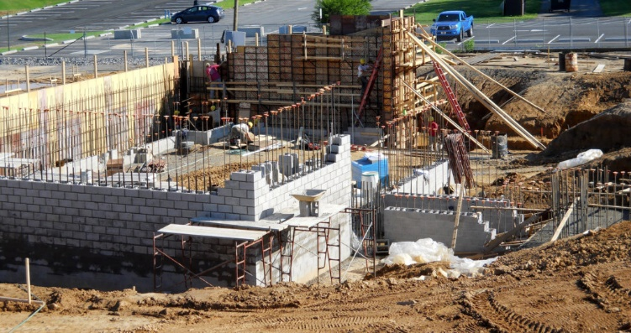
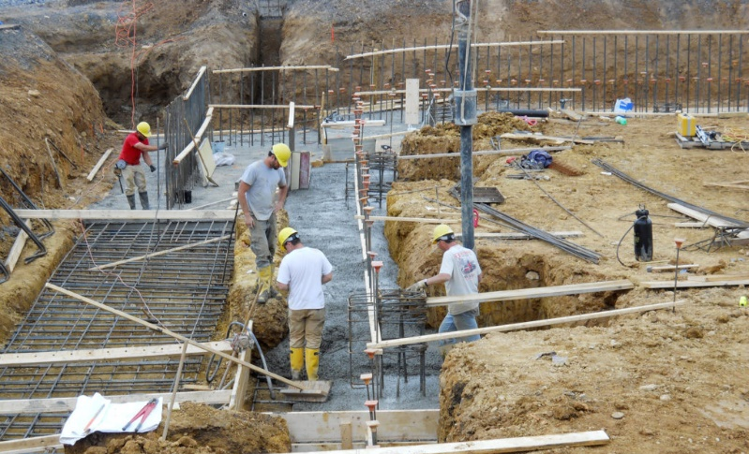
Foundation Design: Lessons Learned
Picture: https://www.zartman.com/pf/academic-west/
Notes:
I just gave you a bunch of facts. Let’s drive home the importance of collaboration in particular with a story.
About 10 years ago, I had just passed my PE exam and this project at Bucknell University in PA was the first project I was working on afterwards. It was also the first project where I had a personal connection to one of my employer’s architectural clients. One of the architects responsible for getting the project was a guy by the name of Rick. Now, my parents knew Rick before I was born. He was a friend of the family, and two of his children went to Bucknell. This was my employer’s first project in recent memory with this architectural client also. So, although we always want to do excellent work, on this one nothing sort of perfection was going to work for me. It would have literally been like disappointing my parents.
We got through SD’s, and it was time to put out a geotechnical RFP. We put that out, and a local geotechnical engineer we hadn’t worked with before, but whom the university was comfortable with, was hired. We worked out the loads based on the current architectural layout, borings were done, and when the report came back we had a recommendation for a mat foundation.
The only problem was that the project budget had only included shallow foundations. Initial estimates were that it would be almost a million dollar difference between the two systems due to the large footprint of the building. The project and university didn’t have an extra 1 million dollars, and there was no way to VE that amount without cutting program.
As I was sitting there one afternoon, pouring over the report, I noticed a sentence that implied that the loads were too high for a shallow foundation system. So, we got the geotechnical engineer on the phone and had a discussion about that interpretation, where we found out that if we could reduce the loads by adding columns we could go back to spread footings. Needless to say, we all worked together relaying out things to find a more cost effective solution.
Now, I tell that story because up until that point, I hadn’t really known that a geotechnical report can and should be questioned. I assumed – as a lot of young engineers do – that it was gospel. That lesson entirely changed my way of thinking, and drives home the value of collaboration.

Slide 21
Construction Phase
Earthwork & Foundation Contractor
Interpretation of the Contract Documents and Geotechnical Report
Geotech
Field Observation & Field Testing
Structural
Field Observation
Third party Owner Representative
Lab Testing and Special Inspections
Notes:
Now let’s move into the construction phase and talk about the responsibilities related to installation of the foundations after design is complete.
First, we have a earthwork and/or foundation contractor, who has his own least-cost interpretation of the contract documents and geotechnical report. Unless both the structural and geotechnical engineers remain involved during construction the foundation is built based on the contractor’s interpretation of the design drawings.
Because of this reality, engineering consulting firms use language in their contract documents and reports that attempts to limit their liability because of construction means and methods and unforeseen conditions. In many cases there is risk unwillingly taken on by the foundation subcontractors out of economic need or ignorance.
What, therefore is the engineer’s responsibility during construction? Typically the geotechnical engineer will do field observation and field testing.
The structural engineer is limited to field observations only.
Third party inspectors are the owner’s agent and thus have the responsibility to protect the owner’s interest. They do not take on any liability for the design.

Slide 22
Construction Phase
Liabilities of Inspections vs. Observations
Differences between inspections and observations
Providing means and methods field direction when contract scope is observations increases liability.
Construction testing
Original geotechnical consultant should be retained for construction observation.
Notes:
Let’s get into some specifics about the liabilities of inspections versus observations.
Inspection is a comprehensive and detailed examination of all the construction work in progress relative to the design shown on the contract documents. Conversely, observation is the general review of the project at appropriate intervals during construction. Observation does not involve detailed inspections to provide exhaustive or continuous project review. In order to help control future liability arising from construction phase services, the scope of work in the contract should clearly define the role intended to be fulfilled and maybe even more importantly, include express exclusions of the services that will not be provided.
What an engineer does and says while on a project may also affect liability. Even when a contract is limited to “observation”, that limited scope can be usurped if the engineer starts directing the means and methods of the contractor or holds himself out as an inspector. It is essential that the engineer not exceed the scope of services defined in the contract.
There are many reasons why the geotechnical engineer of record should be actively involved in the project from start to finish. No one knows more about the local subsurface conditions and their impact on construction. The recommendations in the final-geotechnical-engineering report are provisional until the geotechnical engineer can observe actual subsurface conditions during construction. If observed conditions differ from those inferred to exist, the geotechnical engineer can quickly modify the provisional recommendations with little or no impact on budget or schedule. If the geotechnical engineer of record is not allowed to perform on-site observation of subsurface conditions the geotechnical-engineering service will remain incomplete, significantly increasing the owner’s risk as well as the structural engineer of record.

Slide 23
Recap
Contractual Relationships
Geotechnical RFP’s
Working with a soils report
Foundation design
Construction Phase
Notes:
Here’s a quick recap of what we’ve discussed today.
Next, we are going to ask a special guest to start our open discussion about how structural engineers and geotechnical engineers can work better together.

Slide 24
Open Discussion
Notes:
Questions
Some owners seem to think that both the geotechnical and structural engineers should hold all risk related to unforeseen geotechnical conditions. Do you have any suggestions for ways we can better educate owners here?
What can structural engineers do to make the geotechnical RFP process go more smoothly?
Tell us about some common mistakes you see engineers make during the RFP process. What should we be doing instead?
So, I’m receive a phone call or I’m sitting in a meeting and someone asks me (as the structural engineer) to put together a boring plan. What are some strategies you would recommend for that situation?

Slide 25
THE PROJECT
Contractors Owners Designers
Build to Plans and Expect Everything Design to Standards
Specifications to be Perfect of Industry – Not to
(Spearin Doctrine) Perfection

Slide 26
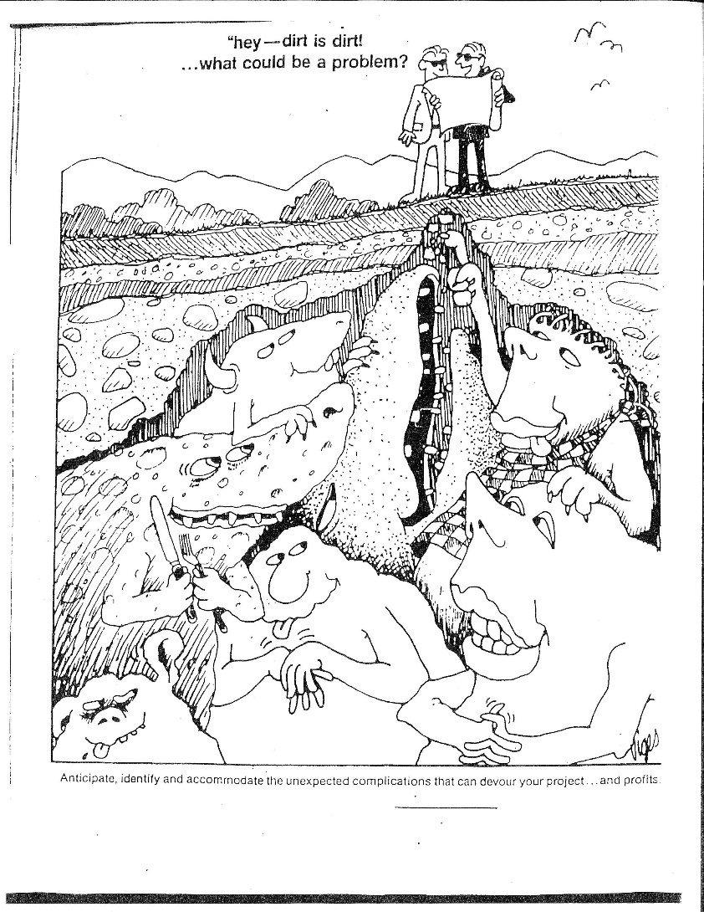

Slide 27
Owners have the risk of an imperfect design being built perfectly by the contractor. Nowhere is the risk greater of being imperfect than below ground.

Slide 28
It is to the owners advantage to get the best Design Geotechnical Report (complete and reliable) possible, not cheapest possible.

Slide 29
Structural Engineers Should:
Provide both load data and performance requirements.

Slide 30
Geotechnical Engineers Should:
Develop Subsurface Program which:
Meets structural engineering needs.
Minimize risk to owner.
Provides economical foundation solution.
Provide explanation as to why the program best meets the project objectives.

Slide 31
Structural Engineers Should Not Put Borings and Depths on Drawings and Then Say Geotechnical Should Change It.
Structural Engineers don’t know what is underground.
IBC discourages this practice.

Slide 32
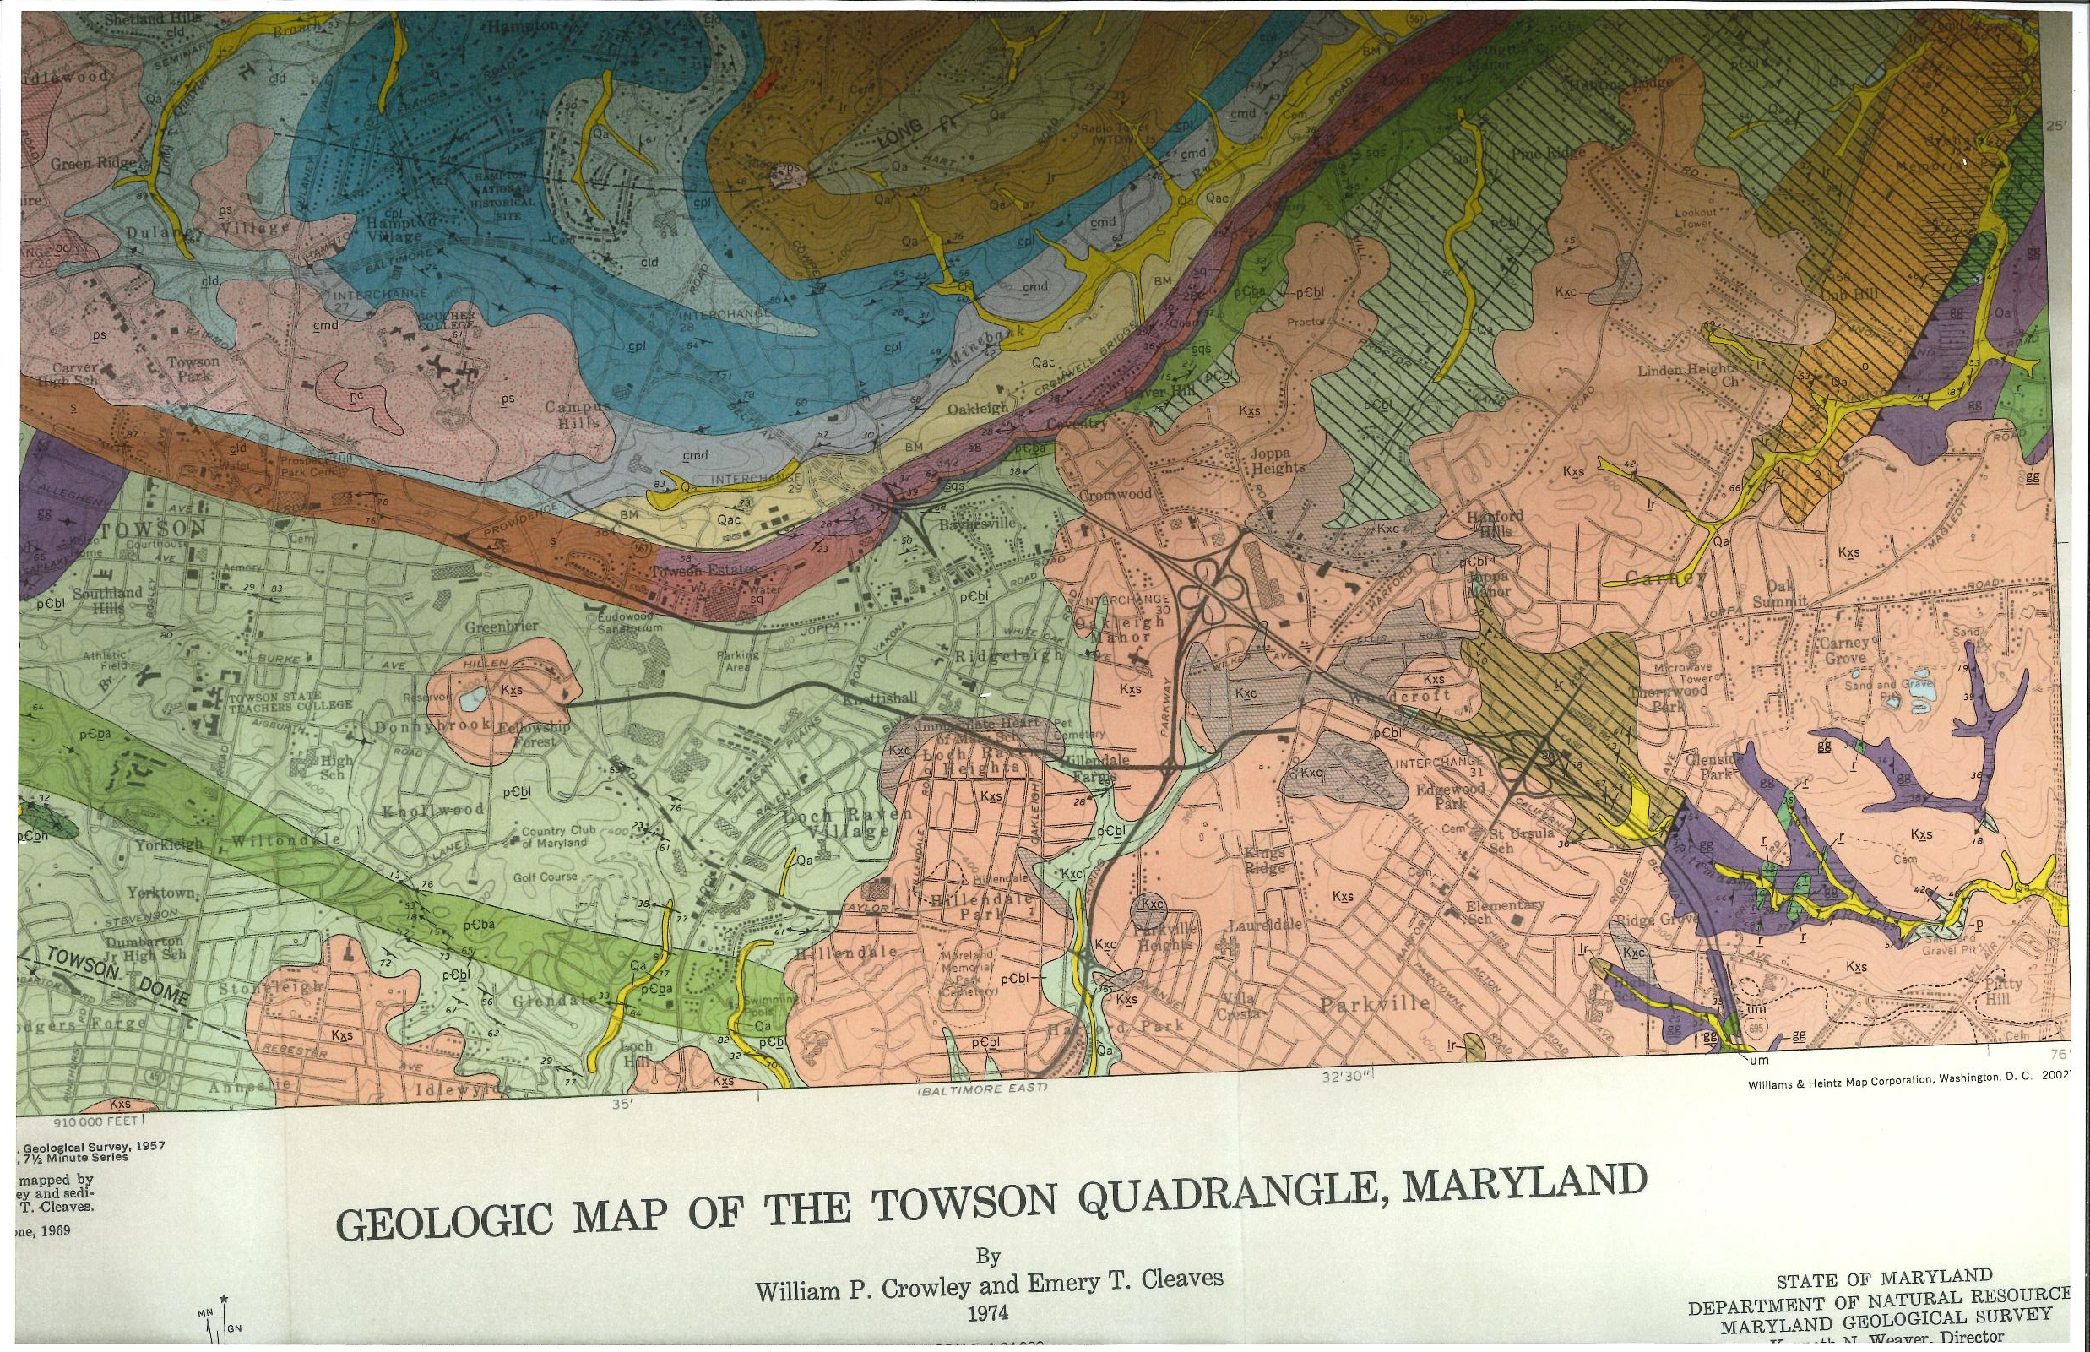

Slide 33
IBC 2018 Chapter 18 Soils and Foundations
1803.3.1 Scope of Investigation
1803.4 Qualified Representative
The scope of the geotechnical investigation including the number and types of borings or soundings, the equipment used to drill or sample, the in-situ testing equipment and the laboratory testing program shall be determined by a registered design professional.
The investigation procedure and apparatus shall be in accordance with generally accepted engineering practice. The registered design professional shall have a fully qualified representative on site during all boring or sampling operations.

Slide 34
Contact info for all presenters, copies of this presentation, and other supporting materials are available for download at:
www.engineersrising.com/seimd

